Slide 1

Lecture 18
Fundamentals and Applications (CSO201A)
Dr. Srinivas Dharavath
Assistant Professor
Department of Chemistry
Indian Institute of Technology, Kanpur
Kanpur- 208016
E-mail: srinivasd@iitk.ac.in

Slide 2
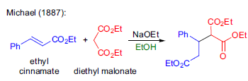
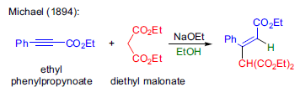
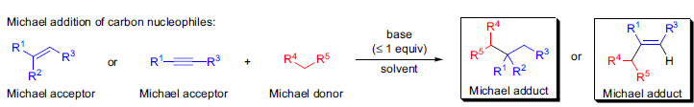
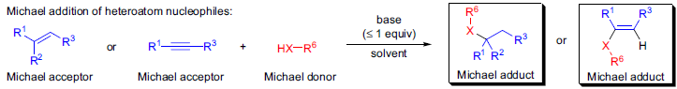
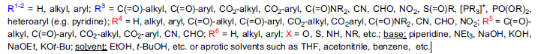


Michael Addition/Reaction
This method of forming new carbon-carbon bonds became exceedingly popular by the early 1900s and today the addition of stabilized carbon nucleophiles to activated π-systems is known as the Michael addition (or Michael reaction) and the products are called Michael adducts.

Slide 3
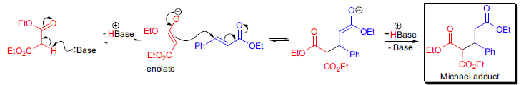
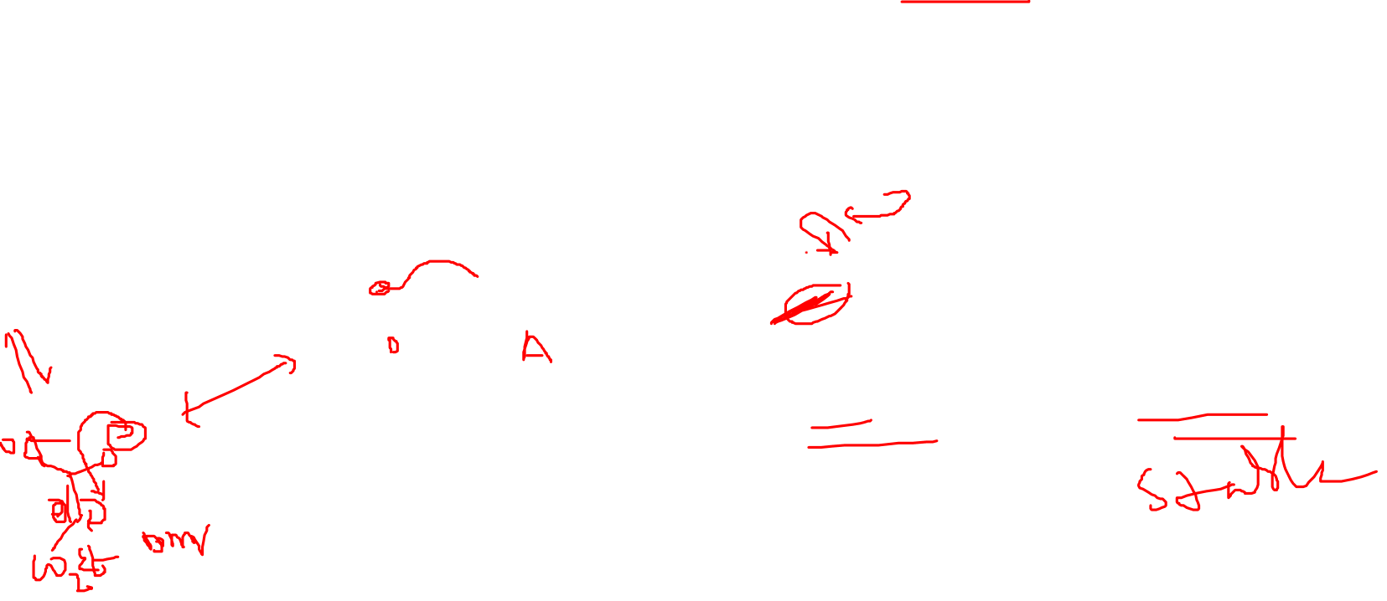
Michael Addition/Reaction
The mechanism is illustrated with the addition of a malonate anion across the double bond of ethyl cinnamate. The reaction is reversible in protic solvents and the thermodynamically most stable product usually predominates. When organometallic reagents are used as Michael donors (e.g., copper-catalyzed organomagnesium additions) SET-type mechanisms may be operational.

Slide 4
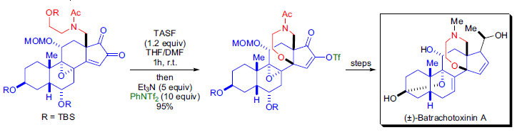

Examples
A unique class of steroidal alkaloids, the batrachotoxinins, is isolated in small quantities from the skins of poison arrow frogs and also from the feather of a New Guinea bird. One of the key steps during the total synthesis of (±)- batrachotoxinin A by Y. Kishi et al. was a Michael addition to form a seven-membered oxazapane ring.68 The removal of the primary TBS protecting group was achieved by treatment with TASF and the resulting alkoxide attacked the enone at the β-position to afford an enolate as the Michael adduct. The enolate was trapped with phenyl triflimide as the enol triflate.

Slide 5
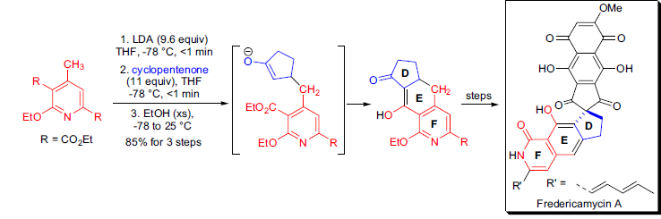
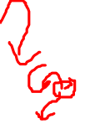
Examples
The synthesis of both enantiomers of the antitumor-antibiotic fredericamycin A was achieved in the laboratory of D.L. Boger. The DE ring system of the natural product was assembled via a tandem Michael addition-Dieckmann condensation. The highly substituted 4-methylpyridine precursor was treated with excess LDA followed by the addition of the Michael acceptor cyclopentenone. The Michael adduct underwent an intramolecular acylation with the ester functionality in situ to afford the desired DEF tricycle.

Slide 6
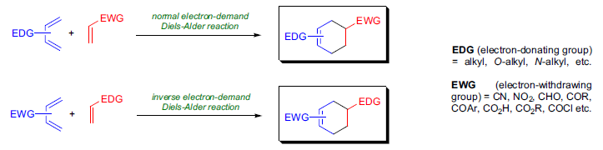

Diels-Alder Cycloaddition
The [4π + 2π] cyclization of a diene and alkene to form a cyclohexene derivative is known as the Diels-Alder cycloaddition (D-A cycloaddition).
The diene component is usually electron rich, while the alkene (dieneophile) is usually electron poor and the reaction between them is called the normal electron-demand D-A reaction. When the diene is electron poor and the dienophile is electron rich then an inverse electron demand D-A cyclization takes place.
If one or more of the atoms in either component is other than carbon, then the reaction is known as the hetero-D-A reaction.

Slide 7
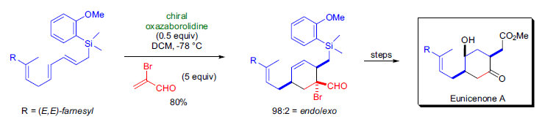
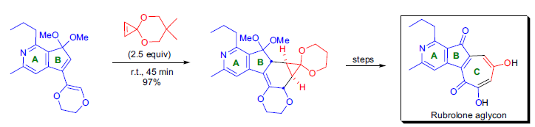

Examples
The critical step in the enantioselective and stereocontrolled total synthesis of eunicenone A by E.J. Corey et al. was the highly efficient chiral Lewis acid catalyzed intermolecular Diels-Alder cycloaddition reaction.89 The diene component was mixed with 5 equivalents of 2-bromoacrolein and 0.5 equivalents of the chiral oxazaborolidine catalyst in CH2Cl2 at -78 °C for 48h. The reaction gave 80% of the desired cycloadduct in 97% ee and the endo/exo selectivity was 98:2
The total synthesis of the rubrolone aglycon was accomplished in the laboratory of D.L. Boger as part of the ongoing research to explore the cycloaddition reaction of cyclopropenone ketals. The key step in the production of the seven-membered C-ring was the intermolecular Diels-Alder reaction of an electron-rich diene with the very strained dienophile. The cycloaddition took place in excellent yield (97%) and with complete disastereoselectivity.

Slide 8
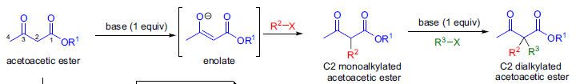
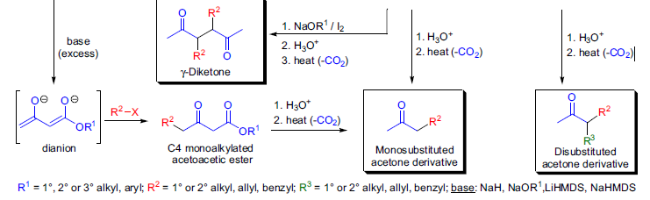
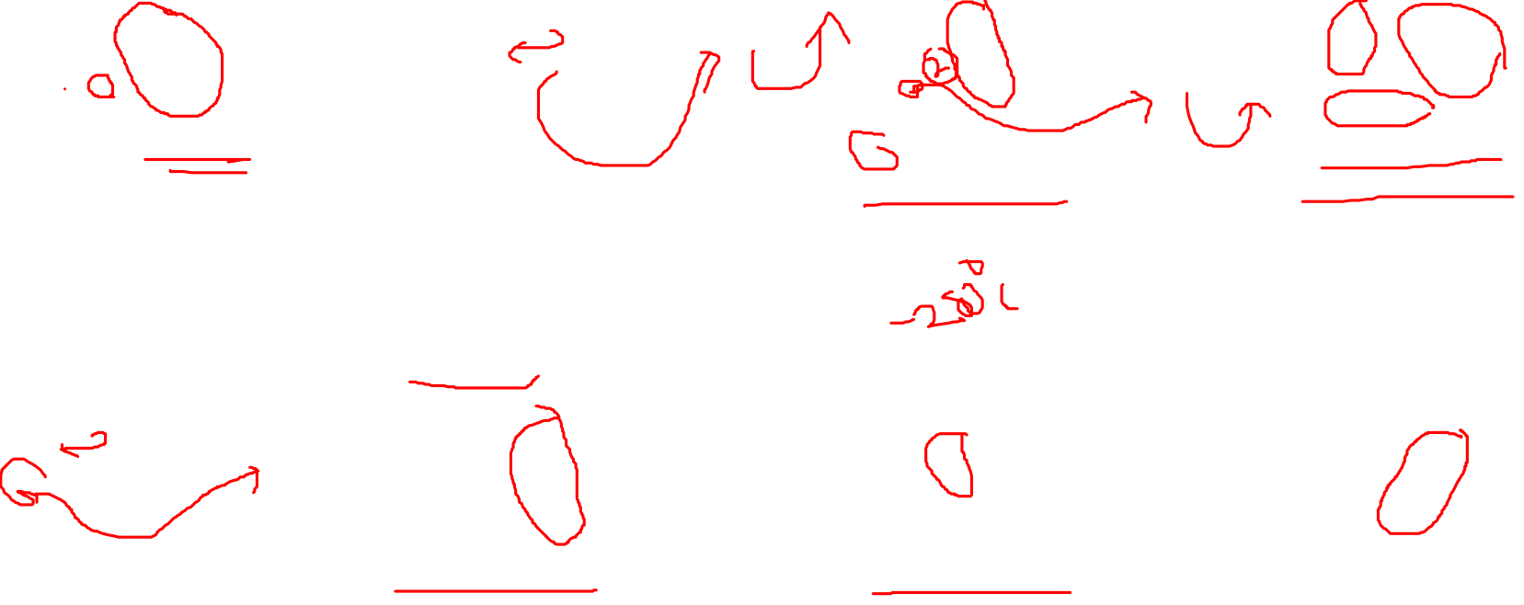
Acetoacetic Ester Synthesis
The preparation of ketones via the C-alkylation of esters of 3-oxobutanoic acid (acetoacetic esters) is called the acetoacetic ester synthesis. Acetoacetic esters can be deprotonated at either the C2 or at both the C2 and C4 carbons, depending on the amount of base used. The C-H bonds on the C2 carbon atom are activated by the electron-withdrawing effect of the two neighboring carbonyl groups.

Slide 9
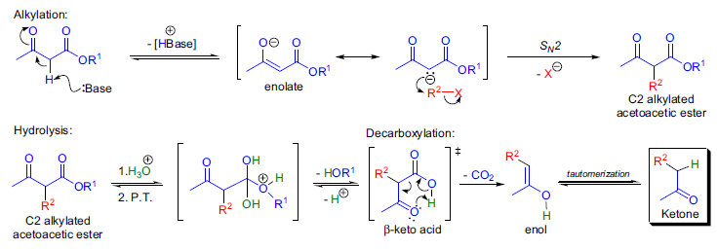

In the mechanism, the first step is the deprotonation of acetoacetic ester at the C2 position with one equivalent of base. The resulting enolate is nucleophilic and reacts with the electrophilic alkyl halide in an SN² reaction to afford the C2 substituted acetoacetic ester, which can be isolated. The ester is hydrolyzed by treatment with aqueous acid to the corresponding β-keto acid, which is thermally unstable and undergoes decarboxylation via a six-membered transition state.

Slide 10
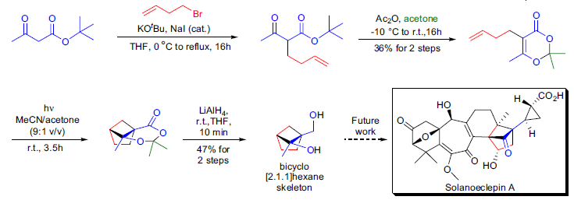
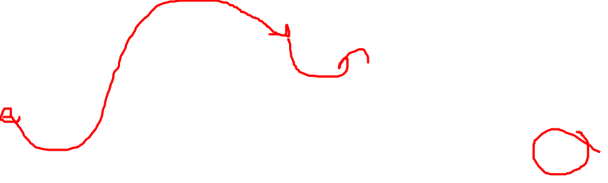
Examples
In the laboratory of H. Hiemstra, the synthesis of the bicyclo[2.1.1]hexane substructure of solanoeclepin A was undertaken utilizing the intramolecular photochemical dioxenone-alkene [2+2] cycloaddition reaction. The dioxenone precursor was prepared from the commercially available tert-butyl acetoacetate using the acetoacetic ester synthesis. When this dioxenone precursor was subjected to irradiation at 300 nm, complete conversion of the starting material was observed after about 4h, and the expected cycloadduct was formed in acceptable yield.

Slide 11
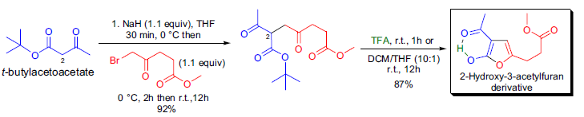
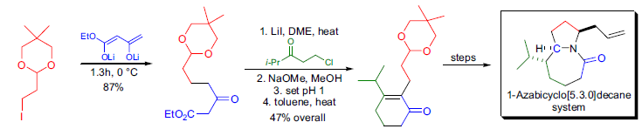

R. Neier et al. synthesized substituted 2-hydroxy-3-acetylfurans by the alkylation of tert-butylacetoacetate with an α- haloketone, followed by treatment of the intermediate with trifluoroacetic acid.22 When furans are prepared from β- ketoesters and α-haloketones, the reaction is known as the Feist-Bénary reaction. A second alkylation of the C2 alkylated intermediate with various bromoalkanes yielded 2,2-disubstituted products, which upon treatment with TFA, provided access to trisubstituted furans.

Slide 12
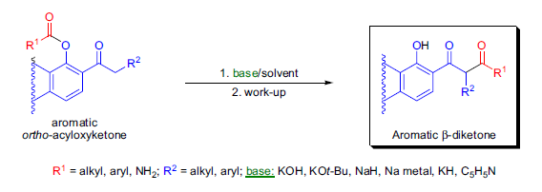

Baker-Venkataraman Rearrangement
The base-catalyzed rearrangement of aromatic ortho-acyloxyketones to the corresponding aromatic β-diketones is known as the Baker-Venkataraman rearrangement. β-Diketones are important synthetic intermediates, and they are widely used for the synthesis of chromones, flavones, isoflavones, and coumarins. The most commonly used bases are the following: KOH, potassium tert-butoxide in DMSO, Na metal in toluene, sodium or potassium hydride, pyridine, and triphenylmethylsodium.

Slide 13
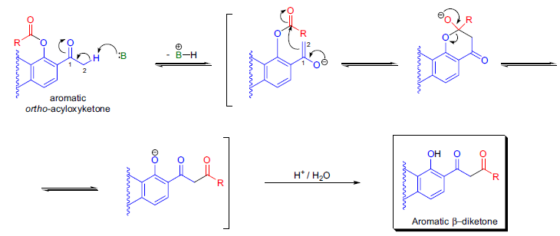

In the first step of the mechanism, the aromatic ketone is deprotonated at the α-carbon and an enolate is formed. This nucleophile attacks the carbonyl group of the acyloxy moiety intramolecularly to form a tetrahedral intermediate that subsequently breaks down to form the aromatic β-diketone.

Slide 14
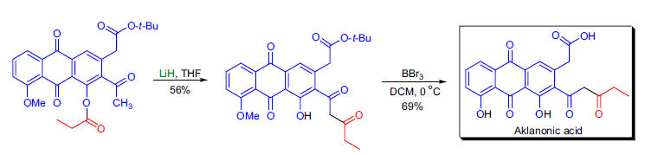
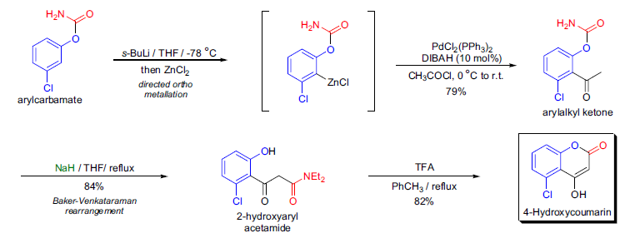

Examples
In the laboratory of K. Krohn, the total synthesis of aklanonic acid and its derivatives was undertaken, utilizing the Baker-Venkataraman rearrangement of ortho-acetyl anthraquinone esters in the presence of lithium hydride. Using this method, it was possible to introduce ketide side-chains on anthraquinones in a facile manner.

Slide 15
